Slide 1


OLIST STORE
DATA ANALYSIS

Slide 2

DATA SETS
There are totally 09 data sets were provided by the Olist company to answer their business questions.
ORDERS
REVIEWS
PAYMENTS
CUSTOMERS
ORDER ITEMS
①
②
③
④
⑤
This table contains the details of each unique orders. (purchase/delivery dates & order status)
It contains the reviews given by the customer for the products they purchased.
This dataset showcase the payments made by the customers for their orders.
This dataset contains the details of all its customers.
It gives us the details of price and freight value of each product with respect to the all the orders.
PRODUCTS
SELLERS
GEO LOCATION
PRODUCT CATEGORY TRANSLATION
⑥
⑦
⑧
⑨
This dataset holds the details of all its products from all the categories.
It contains the informations of sellers who are selling their products across different locations.
It provides the geographical information related to both the sellers and customers.
This dataset provides the translated name for each products in English.

Slide 3



DATA SET RELATIONSHIP

Slide 4



KPI’s
Weekday Vs Weekend (order_purchase_timestamp) Payment Statistics
Number of Orders with review score 5 and payment type as credit card
Average number of days taken for order_delivered_customer_date for pet_shop
Average price and payment values from customers of sao paulo city
Relationship between shipping days (order_delivered_customer_date - order_purchase_timestamp) Vs review scores

Slide 5

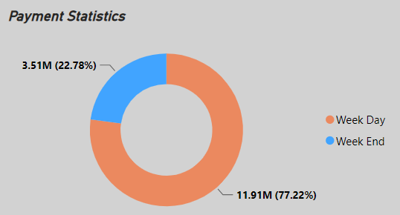
KPI 1
WEEKDAY VS WEEKEND (ORDER_PURCHASE_TIMESTAMP) PAYMENT STATISTICS
INSIGHT :-
After analysing the orders & payments data sets, we dervied the answer for first KPI which shows the majority of sales were done on week days (78% of total payments) that refers, the customers are buying products mostly on week days only.
This will help the company to concentrate on week end sales and plan accordingly.

Slide 6
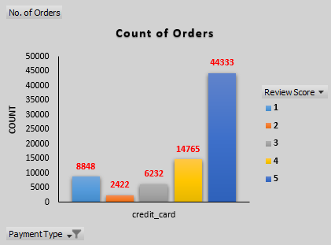
KPI 2
NUMBER OF ORDERS WITH REVIEW SCORE 5 AND PAYMENT TYPE AS CREDIT CARD
INSIGHT :-
From the analysis of second KPI we could see that out of 98K+ orders, 44.3K orders have been made with credit card which has the review score ‘5’.
It is clearly visible that about 75% of their total customers are purchasing through credit cards, in that only 45% customers gave the review score ‘5’.

Slide 7
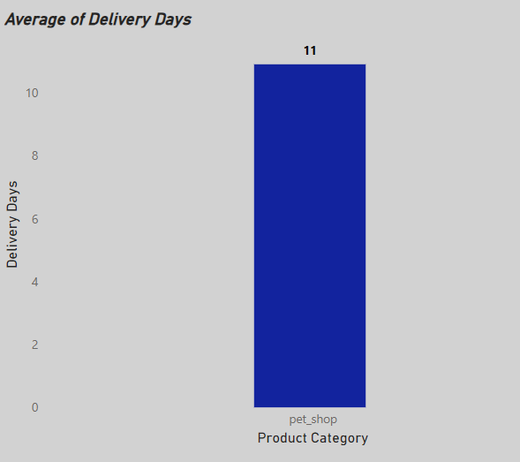
KPI 3
AVERAGE NUMBER OF DAYS TAKEN FOR ORDER_DELIVERED_CUSTOMER_DATE FOR PET_SHOP
INSIGHT :-
This KPI shows that the average days taken for delivering the products of pet shop is ‘11’.
Since the delivery days is quite a long time, the company may focus to increase the delivery methods so that the no. of days taken will get reduce.

Slide 8
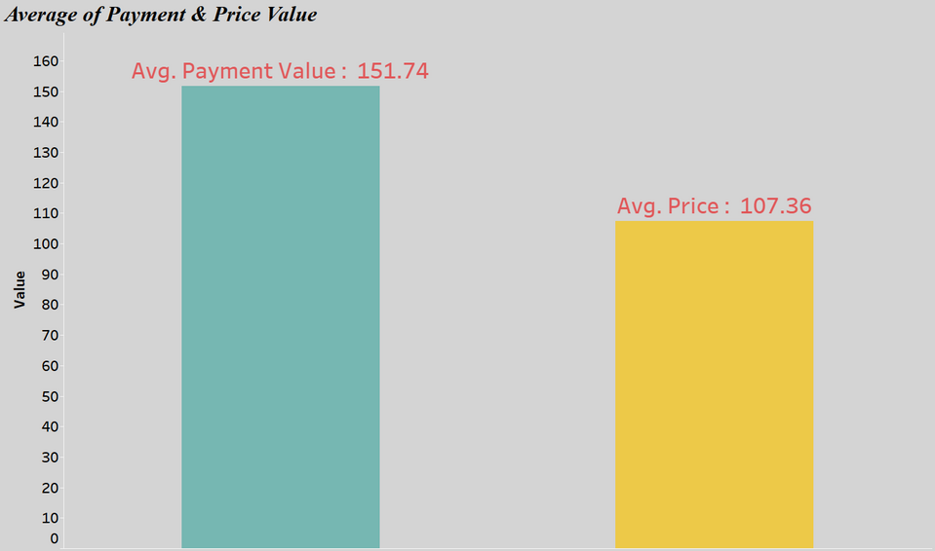
KPI 4
AVERAGE PRICE AND PAYMENT VALUES FROM CUSTOMERS OF SAO PAULO CITY
INSIGHT :-
Sao Paulo city is the most populous city in Brazil.
The average payment and price value in this city is 151.74 & 107.36 respectively.
This KPI helps is understanding the spending patterns of the customers in this region, identifying the high value customers and creating any marketing compaigns.

Slide 9
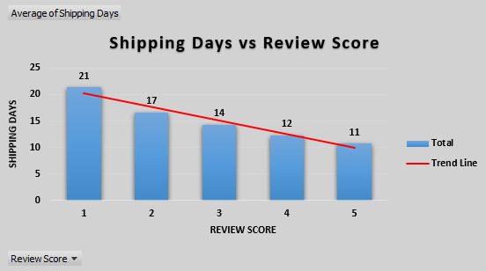
KPI 5
RELATIONSHIP BETWEEN SHIPPING DAYS (ORDER_DELIVERED_CUSTOMER_DATE - ORDER_PURCHASE_TIMESTAMP) VS REVIEW SCORES
INSIGHT :-
We could see that less days of shipping has the highest review score where as the more no. of days has the lowest score.
If the products are delivered to the customers within less no. of days, the customer satisfaction is improved that leads to the positive reviews for the company.

Slide 10

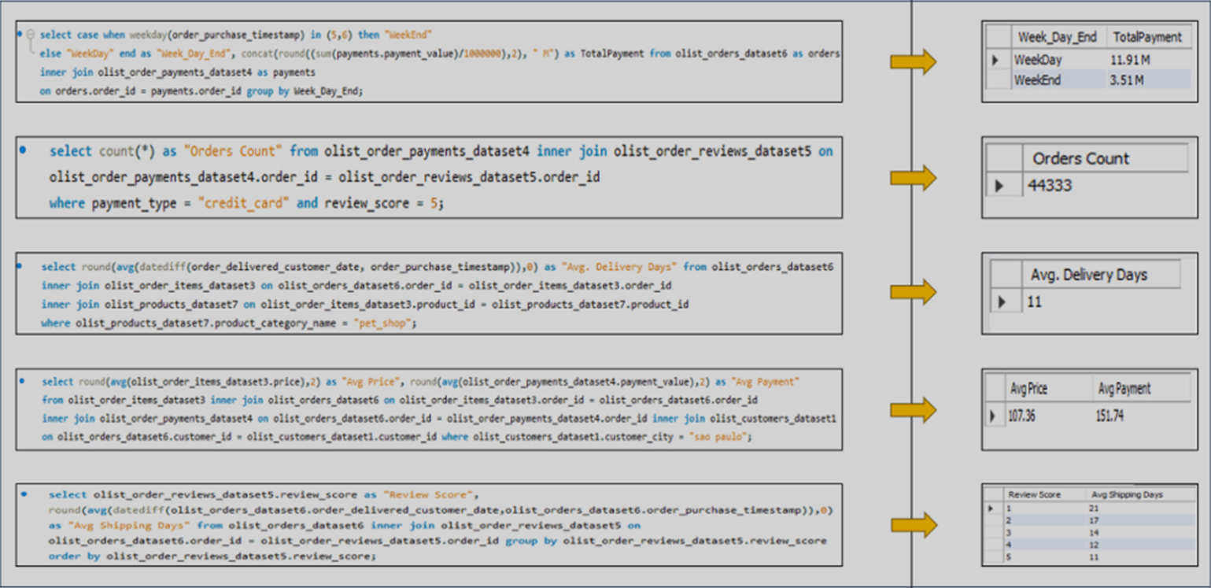
MY SQL QUERIES

Slide 11


D A S H B O A R D S

Slide 12
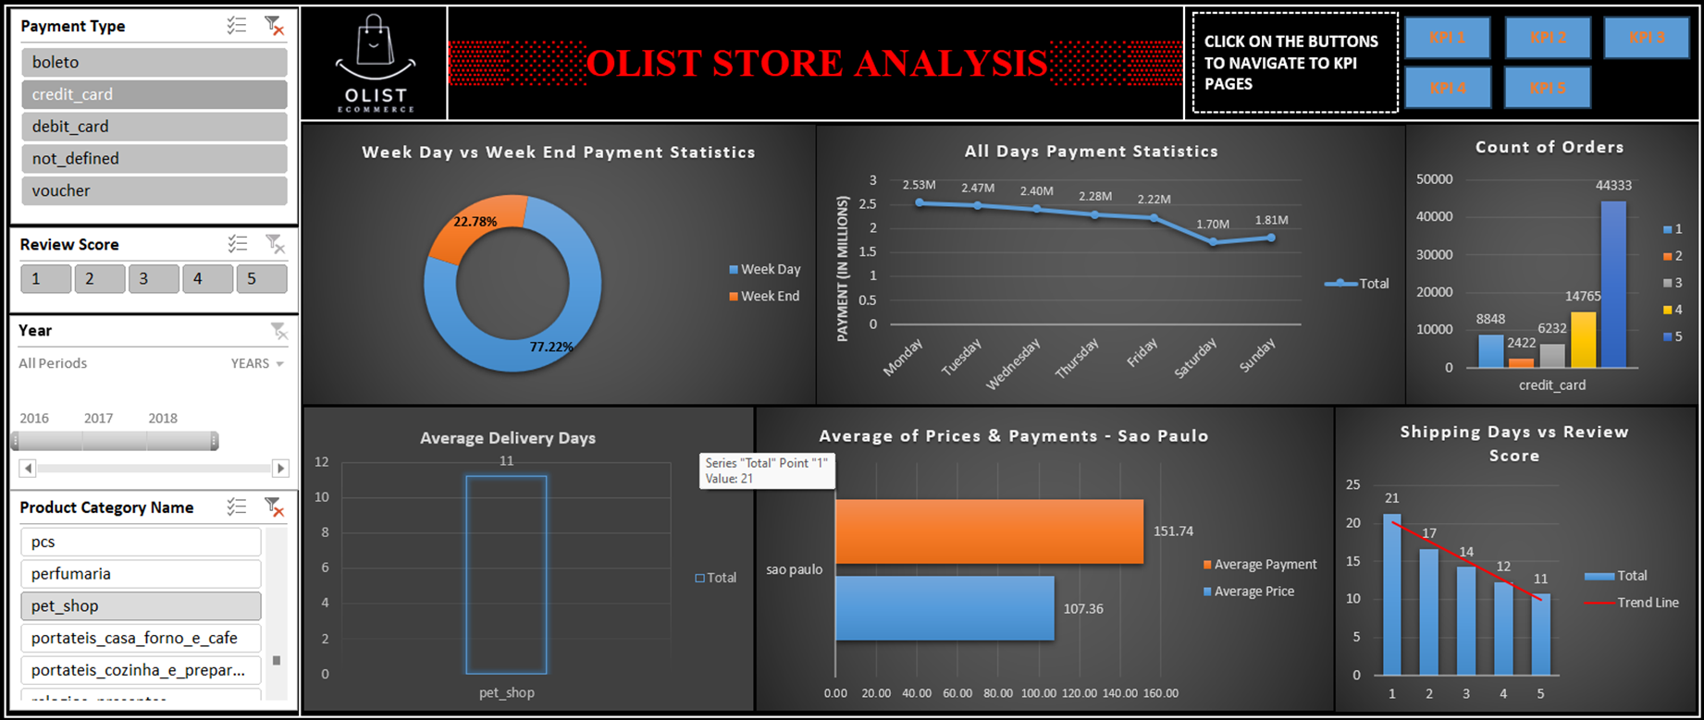
EXCEL

Slide 13
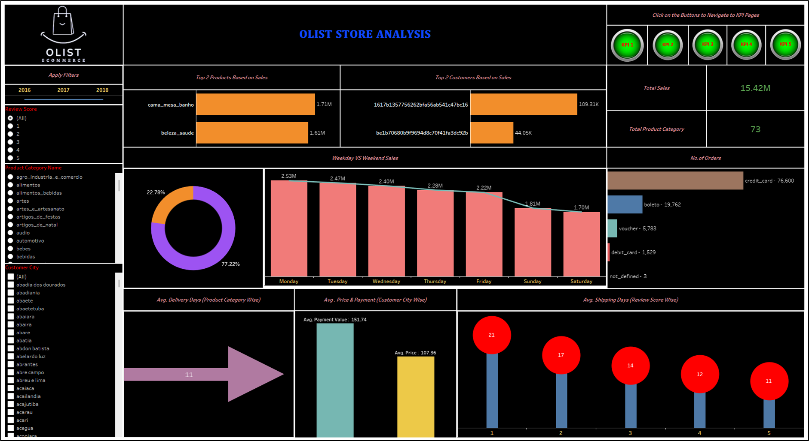
TABLEAU

Slide 14
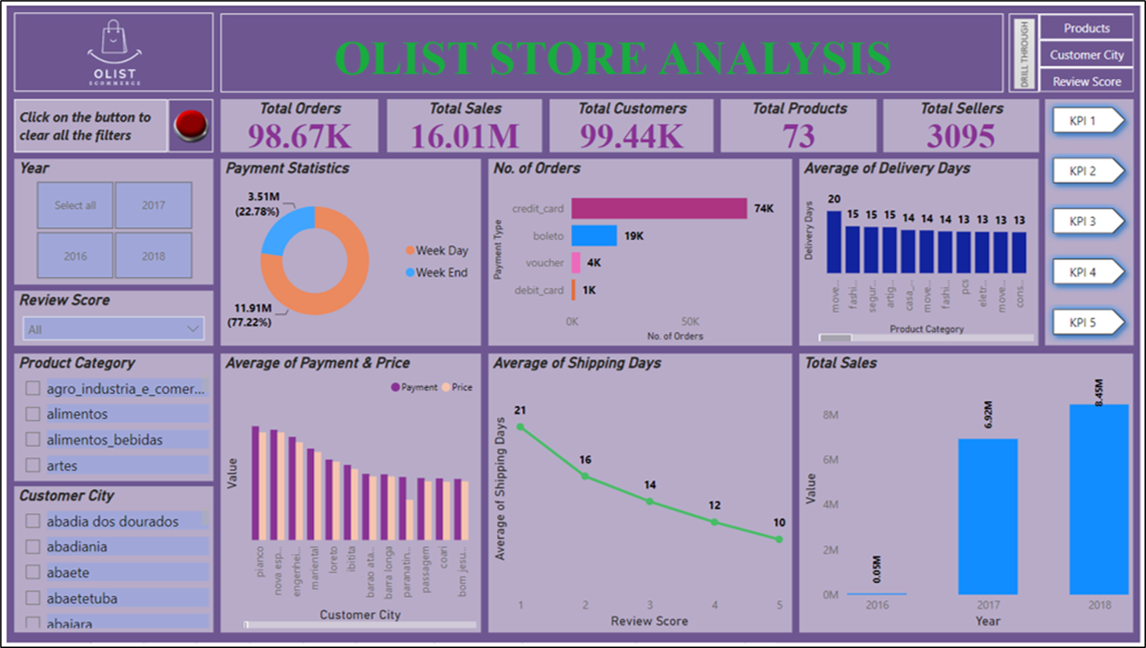
POWER BI

Slide 15
The ‘Olist Store Analysis Project’ provides valuable insights of customers satisfaction and their thoughts on company’s product & service.
The analysis of the KPIs help the company in identifying areas of improvement and to take necessary actions.
It is recommended to concentrate on week end sales, and to provide any special offers so as to increase the sales.
The company can provide any vouchers or special discounts for credit card payments which may improve customer satifaction and accordingly will reflect on customer reviews.
The company can bring more competetive prices to increase the sales and to attract the customers.
Since the long delivery/shipping days affects the customer satsifaction, company shall focus on increasing the delivery methods as much as possible to reduce the shipping days.
The customer’s review is mostly limited to review score, only (30-40)% of total reviews have the proper feedbacks. Hence the company shall implement any new methods/conduct surveys that might let the them understand the customer’s thought on their products & services.
SUGGESTIONS

Slide 16
THANK YOU

